Slide 1
Essay Writing
Content, Coherence and Common Pitfalls
Notes:
Introduction (who I am, that I did the MPhil where they can reach me) and what the topic is.
A lot of this might feel repetitive or like things that you already know but try to keep with it as we go through, as there are probably things that can help you to improve on your essay writing from your undergrad and things that are expected of you specific to the Institute.
There should hopefully be plenty of time for questions at the end, but if anyone has any as we go through, just let me know

Slide 2
Objectives
To outline strategies for deconstructing essay questions and producing essay plans.
To summarise techniques for structuring an essay with a logical flow and coherent overarching argument.
To review key stylistic and referencing principles for effective academic writing
Notes:
As you’ve probably already gathered in your first few weeks, essay writing is the bedrock of these two courses, crim 1 and crim 2, so we’re going to spend some time focusing on how to prepare for, plan, write and revise essays as it’s what you’ll be doing for a lot of the year.
So we’re going to outline strategies for deconstructing essay questions and producing essay plans, look at techniques for structuring an essay logically and coherently, and we will review key stylistic and referencing principles for effective academic writing.

Slide 3
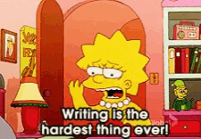
Outline for Today
Mark scheme
Common pitfalls to avoid
Answering the question
Structuring the essay
Developing the content
Critical analysis
Stylistic principles
Format
Referencing
Academic misconduct
Practice essay
Summary
Notes:
So as you can see, we’ve got quite a lot to get through so we’re just going to drive straight in

Slide 4
Essay timetable
 | Michaelmas (October – January) | Lent (January – April) | Easter-to-September
MPhil in Criminology | 1) Practice Essay 2) Criminological Theories Essay 3) Option 1 Essay 4) Criminological Methods Essay/Exercise | 5) Option 2 Essay 6) Option 3 Essay | Dissertation
MPhil in Criminological Research | 1) Practice Essay 2) Criminological Theories Essay 3) Option 1 Essay 4) Criminological Methods Essay/Exercise | 5) SSRMP Exercise 6) Option 2 Essay | Dissertation
Notes:
So as I said, you’ve got several essays to write so I’ve just outlined them here so they can be fresh in your minds as we go through this lecture today.
This is how they are set up for the two courses.

Slide 5
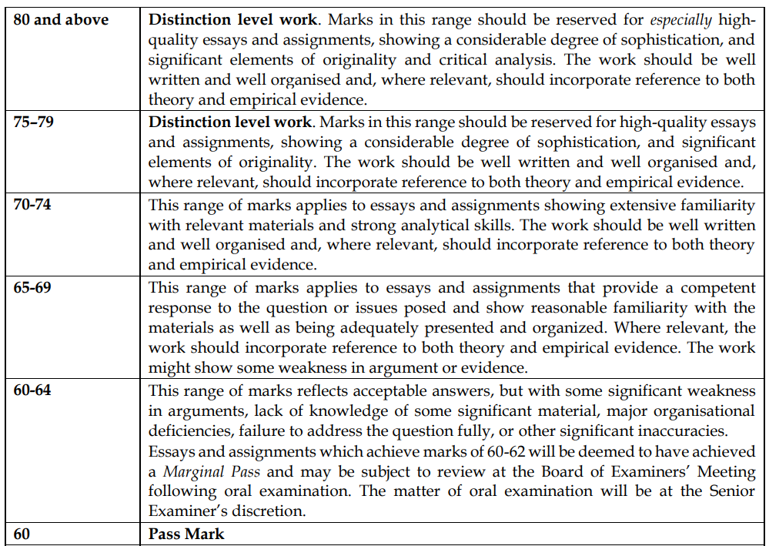
Essay Mark Scheme
See p.42-43 in the MPhil Handbook
Notes:
Here’s the essay mark scheme as it is in your MPhil handbook. For those of you who haven’t had a good look at it, I would strongly suggest that you do.
For those of you who are from the UK or who did your undergraduate at universities in the UK, this will look a bit different to what you might have had previously. Importantly, a mark of 60 (out of 100) is considered as the pass mark, not a 2:1.
This means that this is the minimum you should be hitting to pass essays and modules.
Now that probably seems quite harsh, but this is what Cambridge and the department expects of it’s students. This isn’t meant to scare you but instead to drive you to aim higher and if you follow the guidelines it sets out, and hopefully this presentation, hopefully you shouldn’t have too much of a problem.
What you should all aim for this section right here:

Slide 6
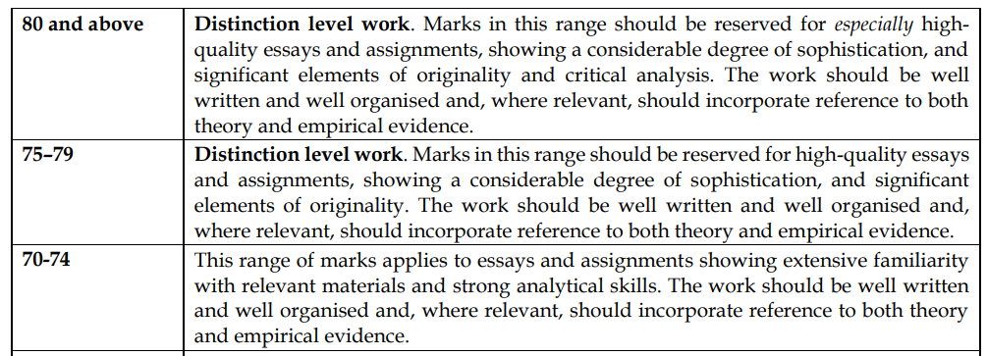
Essay Mark Scheme
Notes:
These are the three upper bands of the mark scheme and ideally, might be what you guys are striving for.
What sets these essays apart from others, particularly the upper two distinction bands is:
That the essay is written with a considerable degree of sophistication
It includes significant elements of originality
Essays are well written and well organised (this refers to writing style, grammar, vocabulary as well as the overall structure)
Reference to both theory and empirical evidence
To reach the top band, essays will critically analyse the topic, the research, the statement (for 80+)

Slide 7
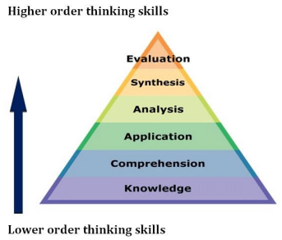
Content
Bloom (1956)
Notes:
I’d just like to introduce you to Bloom’s taxonomy of thinking skills. As you can see, there are six domains of cognitive skills. At the bottom you have the reality basic skills of knowledge, comprehension and application. As you progress up the pyramid, you access more advanced skills (analysis, synthesis, and evaluation).
I’m showing this because I want you to try and display these higher order skills in your essays, to ensure you access the top marks. Whilst knowledge and comprehension is great, and are important to have, they are the basic or minimum requirement. So you need to try to move beyond this using the three upper skills, as this will allow originality to come in and enable you to access the higher marks.
Engaging these six skills will ensure your essay is more rounded, critical, thorough and will help you to access those higher mark bands.

Slide 8

Common Pitfalls
Failure to answer the question
Weakness in argument and evidence
Lack of knowledge of significant material
Organisational deficiencies
Significant inaccuracies
See p.42-43 in the MPhil Handbook
Notes:
As the handbook also outlines, there are some common pitfalls to avoid when writing your essays. Hopefully, by the end of today, you’ll have a good idea about how to avoid each and all of them.
These common pitfalls include:
A failure to answer the essay question
Weakness or weaknesses in the argument and evidence presented in the essay
Lack of knowledge of significant material (i.e. missing or failing to reference key texts or seminal works)
Organisational and structural deficiencies which leave gaps or is difficult to follow
And finally, significant inaccuracies in things like understanding theory, key arguments, and the presentation of empirical evidence. So try to ensure that you know what you’re saying and that it means what you’re saying

Slide 9
Answering the Question
Identify content and command words
    Which key concepts do you need to define and analyse?
    What skills do you need to apply?
‘Question the question’
    What are the main problems the question raises?
    Does the question make any assumptions? Are they justifiable?
    Are there any ambiguities in the question?
Cover all relevant areas
Notes:
It’s common, even at Master’s level, for students to not answer the question of the essay title and therefore end up losing valuable marks. So the first thing that you really need to do is read the question and understand what it is asking of you.
So when you read the question, look for key words that the question is trying to get at:
What are the content and command words of the question? What concepts do you need to define and analyse – so this could be things like ‘crime’, ‘legitimacy’, ‘managerialism’, ‘violence’
And then you need to think about what skills do you need to apply when answering it? So do you need to evaluate a claim, compare two different theories etc.
Then think about how you can interrogate or ‘question the question’, rather than taking it at face value.
Really think about, what are the problems that the question raises and any debates or issues that it raises?
Does it make any assumptions, and if so, are they justifiable?
Are there any ambiguities or contradictions that the question raises.
Make sure you attempt to cover all of these areas and don’t leave things that may be central to the question unanswered.
When it comes time to think about your dissertation, you need to similarly ensure that you pose a research question or questions that your dissertation 1) can answer within the scope and 2) that it does answer.

Slide 10
Answering the Question
Example Q: What is the role of prison staff in shaping the experience of prisoners?
Notes:
What are the content and command words for this example essay question? Or what things do you need to consider?
Things like ‘role’ and ‘experience’, ‘shaping’ and ‘prison staff’
It also asks ‘what is the role’ (so you can think a little too about what the role is in theory, what is it in practice, and thinking ahead, what should it be.

Slide 11
Essay Structure
Plan the structure of your essay
    Identify key arguments
    Calculate word counts (can be up to 5% more than the word count)
    Discuss with your supervisor
Organise material effectively
Introduction
Body Paragraphs
Conclusion
Notes:
Planning out and structuring your essays is crucial to ensuring a coherent and well developed argument.
We’ll look at each main section in turn in a second, but in thinking about planning, you need to:
Use your reading and lectures to identify the key arguments you want to make in response to the questions
You can do this by also talking to your supervisor about topics
You should also think about word counts for each section. I always run over these initial predictions but they’re helpful guidelines so that you don’t end up having to cut 2000 words and help to provide a broad framework for how much you can include
It’s important to remember you can’t include everything you read about or want to say, so think carefully beforehand about what is the most important
Try to then organise this effectively so that main points/arguments can logically flow one into the other (you don’t want it to be too fragmented or jarring)
Anything more than 5% over the word count will result in mark deductions.

Slide 12
Introduction
Broader context
Key issues and importance
Thesis statement
Argument, position, response
Main points
Describe the structure
Maximum 10% of word count
Notes:
A strong introduction should look to set out:
The broader context, a thesis statement and the main points of the essay
So firstly, it should address the broader context in which the essay question in set (so it should talk about the context of the topic and be able to identify the gap in knowledge to which you aim to respond)
In doing so, it should highlight the key questions and then demonstrate their importance (so going back to thinking about those command words and what it is asking you)
It should provide a thesis statement on the positionality of your argument (i.e. what your response is to the question, and potential alternative arguments)
Finally, it should introduce the key issues to be discussed through signposting. So it should outline what the essay will cover and in what order to help guide the reader through the essay more easily.
Your introduction sets the tone for the rest of the assignment and a strong introduction will help to hook your reader.

Slide 13
Paragraphs
Topic
Introduces the focus of the paragraph
One main idea per paragraph
Structuring paragraphs
    Point, Evidence, Explanation and Link
Apply the BBC test
    Build, blur, or corrode the argument
Reasonable length (150-200 words)
Body
Arguments, reasoning, explanation
Tokens
Evidence, examples, references, quotations
Wrap
Summarise argument, add value, link to next paragraph
Notes:
A logical structure of paragraphs helps to guide the reader through your arguments to your conclusion
Importantly, you should try to have only one main idea per paragraph
You can split your essay using headings and subheadings which have broader themes but then each paragraph should still only have main idea/point
But you should try to link these all together
In terms of structuring paragraphs, you can think of a few different frameworks
The PEEL or the topic, body, tokens and wrap are essentially the same but provide a guide to what paragraphs should explore or include
Firstly, they should introduce the main point of the paragraph
Secondly, you should use the body of the paragraph to set out your arguments, reasoning, and explanations for the point
Thirdly, you should provide evidence, examples, references to reinforce this point
Finally, you should provide a summary that links back to the question or the next paragraph, outlining why this extended or challenged the argument
You can also look to apply the BBC test which looks to examine sentences in a paragraph to identify their contribution to the argument: so does it 1) build upon a point, 2) blur a point, or to 3) corrode the argument
‘Building’ looks to advance the argument being made. It makes a new point, takes a previous point further, develops a new angle, offers fresh evidence or explains important detail — so as to advance readers’ understanding.
‘Blurring’, alternatively, does not clearly advance the argument, perhaps because it is repeating something already said, connecting back to an earlier point, or woffling around unimportant detail
‘Corroding’ sections can either: 1) challenge things that are theoretically incorrect, factually wrong, or unevidenced, or 2) the point may be completely ‘correct’ but still misplaced that you are looking to challenge

Slide 14
Content
Main substance of the essay
Ensure your arguments are:
    Clear, well-founded and provide robust evidence from reliable sources
Critically evaluate a range of sources
Synthesize relevant literature
    Required, further, and additional reading
    Identify links across the course and other modules
Focus on a select number of topics or arguments
Notes:
The content is the main substance of the essay or written assignment.
You should ensure your arguments are clear, well founded and that you provide robust evidence from reliable sources (and reference them appropriately)
The content of the essay should demonstrate familiarity with the literature and wide reading of scholarly sources
Any written piece of work will involve a literature review of some sort which will present, synthesize and discuss relevant work by others
This helps to situate the discussion and essay topic within existing academic work
You should take care to consider both classic and contemporary works, to think critically about others’ arguments, methods, interpretation of findings, and the implications for your main arguments, and to reference properly
Generally, it is better to focus on a select number of topics or arguments and develop and evidence them effectively than to cover many topics superficially
Consider your word limit in deciding how many topics you can cover and how much space you can devote to each.
Try to avoid devoting too much space to discussions that are not effectively moving forward your answer to the essay title or research question
Instead, you should devote more space to arguments and evidence (rather than, for example, giving a half a page example)
You want your examiner to know what argument or point you are making, rather than questioning why you are telling them this
You should aim to make clear arguments with good rationale and reliable evidence to support them
For example, when thinking about theory, it’s important to be selective (rather than example every theory that could be relevant). Take time to consider which are most relevant and explain why – and this can help to form the basis of critical discussion and analysis
When presenting research findings, either your own or those of others in the literature, try to consider the statistical and/or real-world significance of what these findings suggest
i.e. how strong is the reported effect statistically (e.g. is it reliable? How does it compare to other effects?); and how strong is it substantively (e.g. what proportion of people does it effect? How much does it affect them?)?

Slide 15
Conclusion
Restate
thesis
Summarise main arguments
Closing comments
Significance, future research, policy implications
Maximum 10% of word count
Notes:
And when finishing your essay, you have your conclusion.
Your conclusion summarizes your answer to the research question and your key arguments/evidence.
In doing so, you should look to:
Restate your thesis
Summarise main arguments made throughout the essay
Make some closing comments about the significance of your conclusion or current state of the topic, future research that could/should be done and potential policy implications that might have.
Other than these suggestions, you shouldn’t look to ad anything new in to your conclusion (i.e. don’t add new arguments you haven’t discussed above)
It is the last thing your reader/examiner will read and your final opportunity to show what you have argued and to inform and convince your reader/examiner you have answered the research question.

Slide 16
Critical Analysis
Discuss strengths and weaknesses
    Theories: concepts, assumptions, mechanisms
    Empirical studies: methods, measurement, sampling, analysis
Identify supporting or discrediting evidence
    Can conflicting findings be explained or reconciled?
Identify gaps or uncertainties in existing research
    Lack of knowledge production in the Global South
    The ’replication crisis’ in scientific research
Engage with counter-arguments
Notes:
Something that students really struggle with is critical analysis. If you remember the mark scheme from earlier, this is only really required to access the very top grades, with 80+.
Critical analysis is really important because it moves beyond a purely descriptive essay to a deeper, more evaluative essay of the current literature.
There are lots of ways to do this, and to critically analyse a theory, or a study.
You can discuss the strengths and weaknesses of theories (you’ll probably already be doing this in your criminological theories course)
You can do so by critiquing the concepts, assumptions, mechanisms
You can also think of the strengths and weaknesses of empirical work (which you’ll also probably be already doing in your criminological research course) and you can think about a lot of different things, like the suitability of methods in answering the research question, the validity and reliability of measurements, you can think about sampling limitations and implications for generalisability, and think about the conclusions which are drawn and the justifications for the conclusions, and whether they are justified.
A second way to show critical analysis is to identify supporting or discrediting evidence. There is often conflicting evidence and the best essays will acknowledge and will go beyond just describing them and try to explain or reconcile them.
Could ask whether there was differences in the methods or differences in the samples or in analytical techniques and try to show originality to contribute to the wider discussion
A third way to show critical analysis is to identify gaps or uncertainties in the research. Something that is becoming increasing common is the awareness of the lack of knowledge generated from the Global South (you’ll probably be able to tell from your reading lists that most criminological research is centred around Western, and white cultures) – so starting to think about what this means for the general applicability of research
Finally, you can show critical analysis by engaging with counter-arguments and to think through the implications of each and the implications for your own arguments.

Slide 17
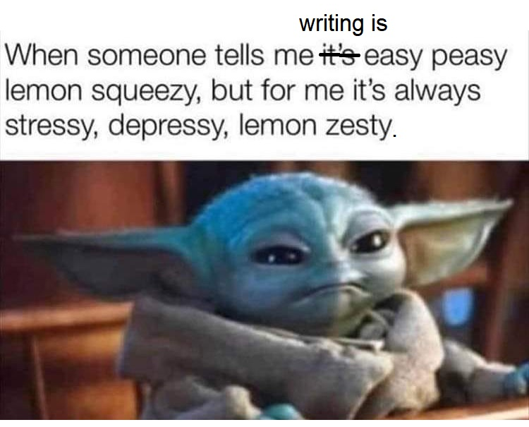
Notes:
This is definitely me, but might be some of you too. So I’m going to talk through a couple of techniques that might make it a bit easier

Slide 18
Stylistic Principles
Continuity and transitions
Clarity, coherence, and concision
Precision
Short or mixed-length sentences
Plain English
Active or passive voice
Tell a story
Notes:
You may lose marks because of poor expression and writing style, which happens often but is often neglected. So it’s important to consider:
Is your essay easy to read?
Is it written in a style which flows smoothly and logically from one issue to the next?
Does it communicate your ideas clearly?
Having someone else read through your work, particularly someone who is not as familiar with the topics as you are, can be very helpful in checking for clarity. With this, it’s okay to ask family members or friends, but be careful when sharing essays between you as a cohort, as you want to ensure you avoid collusion or plagiarism.
You also want to ensure your writing has continuity – which is the logical consistency of expression throughout the piece of work
One way to achieve this is to use the last sentence of the previous paragraph to transition to the next one
Using sentences to provide continuity can break up the monotony of relying entirely on transition words, but these remain important anyway
When transitioning, you want to avoid constantly saying ‘however’ ‘however’ ‘however’ and should look for other phrases that extend both your vocabulary and also make a more clear link
Second, the three C’s (clarity, coherence, and concision):
Clarity: the main task for a writer is to ensure their readers can effortlessly understand the main ideas of the essay
Coherence: the goal of coherent writing is to ensure the smooth flow of ideas. The reader should be able to follow your writing without expending too much effort
Conciseness: always convey your ideas with as few words as possible
Try to avoid complex, lengthy sentences and long paragraphs. In doing so, you want to be precise.
Concision looks to communicate information in as few words but precision looks to communicate all the required information.
A variety of sentence structures can also help to provide a smooth, engaging reading experience. Alternate between simple, compound, and complex sentences.
Having grammatically correct sentences is important but it’s more important to consider how they read and feel to the read. Do you have three really long sentences back-to-back which will exhaust the reader, or is there a lot of short, simple sentences which can feel abrupt, or choppy?
The easiest way to check this is to read it out loud and you will immediately realise any issues if you’re struggling to read a sentence all in one go
This also helps you to realise if you use a lot of the same words and if it feels repetitive
Try to use plain English. You’re more likely to be marked down if you’re trying to be overly academic and are being too flamboyant or are difficult to comprehend than if writing clearly and coherently.
This is particularly important when paraphrasing, don’t overdo it just because you’re avoiding plagiarism. If you can’t explain what the source says clearly, just quote it directly.
Try to consider your tone of voice and whether it is active or passive (when a sentence is in the active voice, the subject is the one doing the action expressed by the verb. When it is passive, the subject is the person/thing that is acted on or affected by the verb’s action).
Active voice: The cat was chasing the mouse. In this sentence, 'the cat' is the subject, 'was chasing' is the verb and 'the mouse' is the object.
Passive voice: The mouse was being chased by the cat.
Tell a story: to create a story in academic writing, you can aim to structure the essay around four different sections: exposition, rising action, climax and resolution
Exposition: Introduce the issue and the argument you want to develop.
Rising Action: To build tension, arrange your arguments to build in strength. How each point builds upon the previous one should be clear.
Climax: At the climax, reveal your most convincing reasoning and evidence.
Resolution: In the resolution, the final phase, summarize your arguments, emphasizing the significance of the issue.

Slide 19
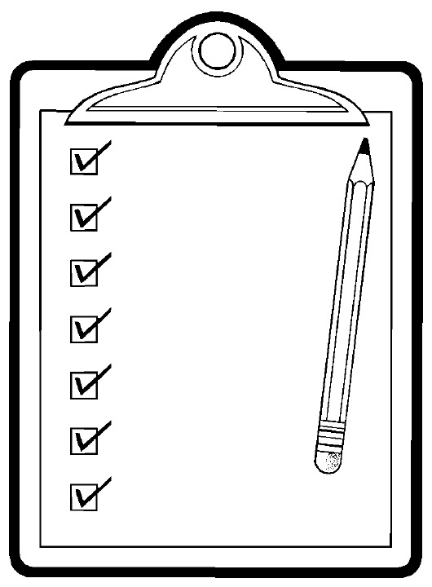
Format
Essays must be word-processed
They should be:
  In A4 portrait format
  Size 12 font
  At least 1.5 line spacing
  Page numbers
They should include:
  A title page (name of the course and number and title of essay question) (in the centre)
  Your candidate number (top right-hand corner)
Notes:
This is all in your handbook, but it’s helpful to just summarise some of it here as well:
Essays must be word-processed
They should be:
In A4 portrait format
Size 12 font
At least 1.5 line spacing
Page numbers
They should include:
A title page (name of the course and number and title of essay question) (in the centre)
Your candidate number (top right-hand corner)
Do not include your name anywhere else on the essay.

Slide 20
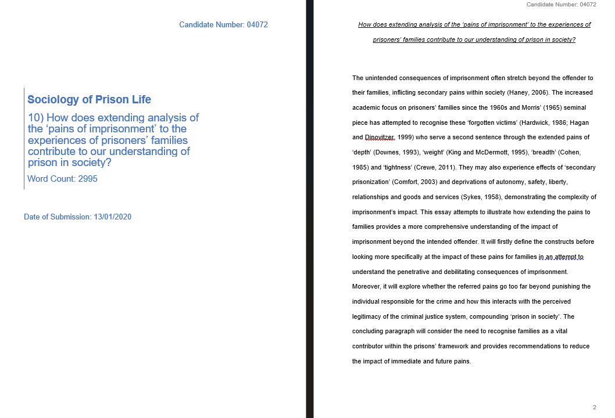
Format

Slide 21
Tables and Figures
You can include tables and figures in your essays
They do not count towards the word count
But be sure to use them effectively and efficiently (only where they help to convey your point further/more clearly)
Notes:
You can include tables and figures in your essays, and are encouraged to do so when they can help convey or clearly articulate your arguments/discussion.
This might be something that is important when you do your SSRMP essay for those of you doing Crim 2.
Tables and figures will not count towards your word count.
However, you should use tables and figures effectively and efficiently. Failure to do so could affect your mark.

Slide 22
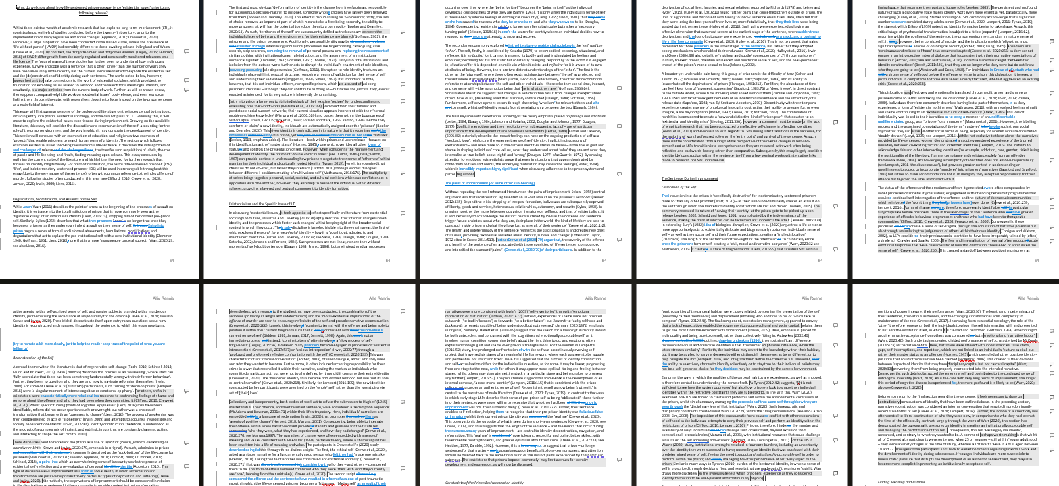

Rewriting and Editing
Allow sufficient time to edit and rewrite assignments
Notes:
Make sure you start early enough so that you can allow yourself sufficient time to edit and do any rewriting if necessary.
Allowing plenty of time also gives you the opportunity to go back to talk to your supervisor about your essay.

Slide 23
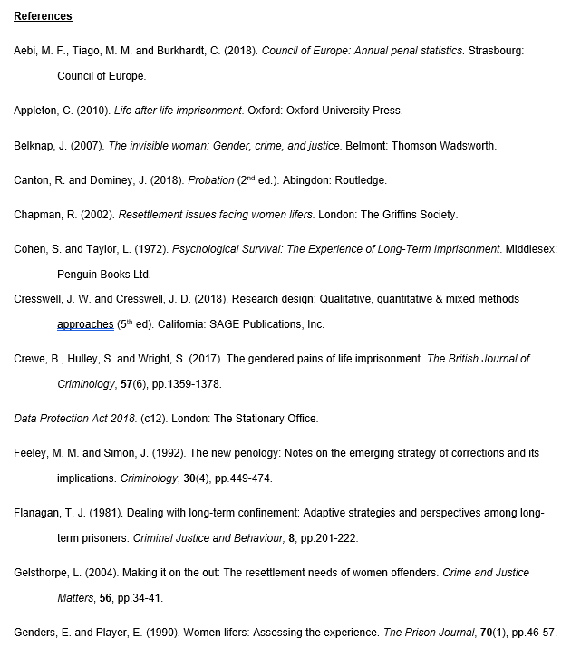
Referencing
Does not count towards the word count
Should include all cited work, rather than all works read
Can use any style of referencing but it must be consistent
Must be organised alphabetically
See the library guides for more information on referencing https://libguides.cam.ac.uk/Official-Publications/referencing
Notes:
All your assignments should include a separate reference list.
Your reference list should come at the end of the essay and does not count towards your word count.
You should reference only the work which has been cited in your essay (or presentation, as you need to reference for those too). You do not need to include works, papers, books which you read but then never included.
Importantly, you can use any style of referencing which you are comfortable with (e.g. APA, Harvard), but it must remain consistent throughout the whole essay.
However, references included in footnotes will count towards your word count, so although it is not wrong to include references in footnotes, I would suggest that you only use footnotes for key asides or points of clarification and put your references in the list at the end.

Slide 24
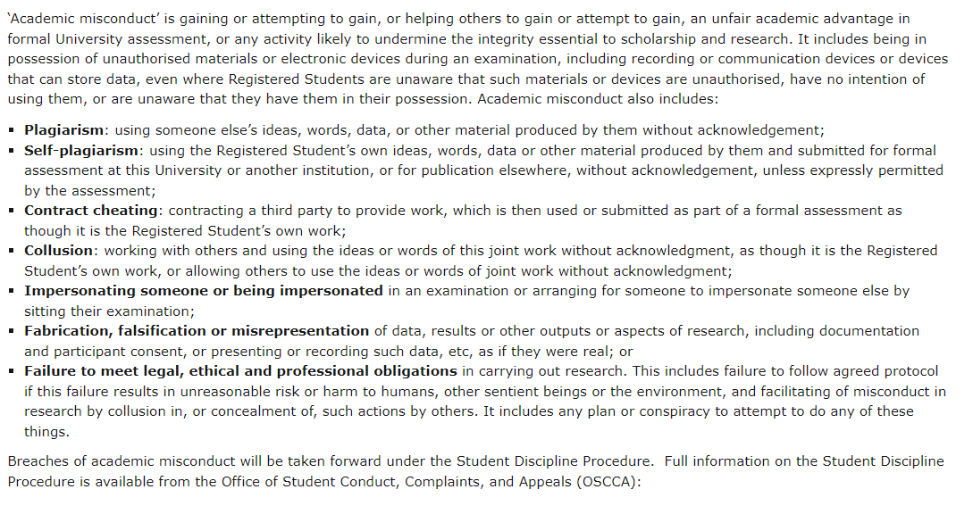
Academic Misconduct
University website: https://www.plagiarism.admin.cam.ac.uk/definition
Notes:
You probably all know about plagiarism, but it’s important just to reinforce it here and other forms of academic misconduct to outline how the university takes it very seriously.
Plagiarism occurs when people draw on or directly replicate someone else’s work and, whether intentionally or not, pass that work off as their own.
You are expected to submit original work for your assessments and to acknowledge all sources upon which you draw.
Failure to do so is both an example of poor scholarship and a breach of academic integrity

Slide 25
Practice Essay
Essay 1: What is crime?
Essay 2: Choose one of the following factors. How is this factor related to offending? 1) social disadvantage 2) delinquent peers 3) contact with the criminal justice system 4) drug use 5) cognitive impairment 6) victimisation
Essay 3: Why do people desist from crime?
Essay 4: What are the main drivers of criminal justice policy?
Notes:
You have the opportunity to do a practice essay in the first few weeks of the course.
Here are the questions that you can choose from.
It’s 1,500 words and doesn’t go towards your grade or anything, but I would highly recommend doing one, because it gives you the opportunity to get the first one under your belt (to implement some of the things we have been talking about) but also to get an idea of how it is marked.
You have until the 1st November at midday to submit it.
You should work closely with your supervisor when preparing for this practice essay but also all your other essays. You can talk to them about what you’re thinking of arguing, what you might have missed, key texts and then for the practice essay, they’ll mark it and give you feedback.
It’s important to remember that your first essay doesn’t have to be perfect but it provides a good opportunity to practice and to see how the mark scheme works.

Slide 26
Summary
Essay mark scheme
    Requirements for a strong MPhil essay
    Common pitfalls to avoid
General guidance
    Techniques for answering the question
    Methods of structuring the essay
    Ideas for developing content
    Stylistic principles for academic writing
    Format and reference
Notes:
Essay mark scheme
Requirements for a strong MPhil essay
Common pitfalls to avoid
General guidance
Techniques for answering the question
Methods of structuring the essay
Ideas for developing content
Stylistic principles for academic writing
Format and referencing

Slide 27
Resources
The Academic Phrasebank
https://www.phrasebank.manchester.ac.uk/
LSE Blog: Writing for Research
https://blogs.lse.ac.uk/writingforresearch/
Academic Development and Training for International Students (ADTIS)
https://www.langcen.cam.ac.uk/adtis/adtis-index.html
Grammerly
https://www.grammarly.com/
Thesis Whisperer
https://thesiswhisperer.com/category/on-writing/
Notes:
Library – loads of books in the library on writing, style and structure

